Slide 1
OEC 2021 Programming
Eric Dai, James Liang, Ryan Zhang, Talha Talha

Slide 2
Presentation Outline
Problem Overview
Introducing our Design
Design and Development Processes
Conclusion and Demo

Slide 3
Problem Overview
Goal: identifying and tracking the outbreak of a deadly, infectious virus in Ontario schools.
Use Python for simplicity, extensive libraries, and object-oriented programming
Libraries: NumPy, pandas, matplotlib, excel libraries
Code focuses on:
Modularity
Generalizability/Flexibility
Ease of Interpretation

Slide 4
Stakeholder Consideration
Potential stakeholders:
Ontario government
Epidemiologists
School staff
Benefits provided by the program:
Possibly let school staff trace where major sources of infection are
Gives epidemiologists a rudimentary model of student interaction to develop further
Ontario government can use the generalized code across many schools, letting them note which ones are at greatest risk of zombie annihilation
Tracks which factors impact the infection more - environment? hobbies?

Slide 5
Design Process
Initially had two ideas:
Graphical approach
Representing student connections as weighted edges
Object-based approach
Modeling students, classrooms as objects
Advantages of second approach:
Computational and space complexity
More compatible with incubation rates in problem

Slide 6
Development Process
Parallelized tasks after spending time framing the problem together
Collaborate and exchanged code to increase efficiency
Github → effective code sharing
Worked well with the modular approach
Extensive use of helper functions
Developed visual model to enhance clarity, presentability

Slide 7
High Level Software Info
Classes developed for:
People
Classroom
Teachers and TAs treated similarly to students
Keep a list of infected students and infectious students
Every period or transition:
Update classrooms by adding to infected list
Simulate infection by modifying a base infection rate, and using a random number generator to randomly infect people

Slide 8
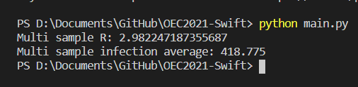
Simulation result

Slide 9
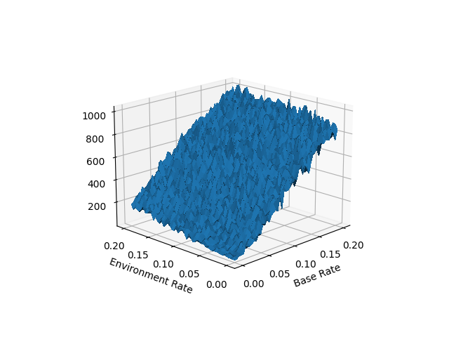
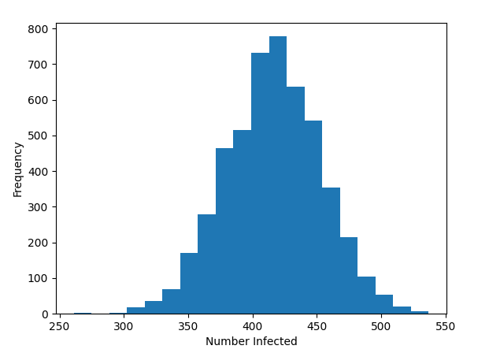
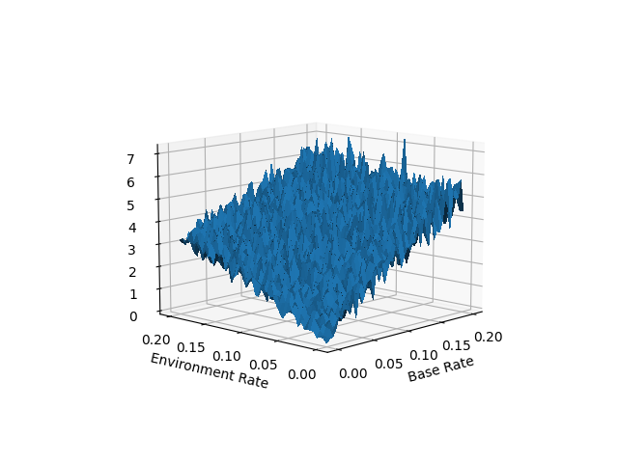
Visualized Results
Number of Infected for Various Environment Rates and Base Rates
Infection Distribution
R₀ for Various Environment Rates and Base Rates

Slide 10
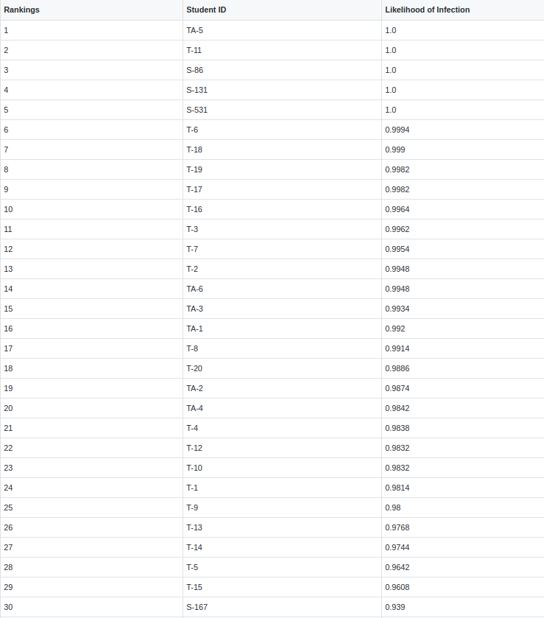

Slide 11
Conclusion and Areas of Improvement
More refined epidemiological model that includes nuances of interactions
Graphical approach would work better for large numbers of infected students
Some speed improvements are possible
Update the model with data collection over extended period of time

